Slide 1
Windows Tech Series Advanced Threat Protection
Speaker 1
Title
Speaker 2
Title

Slide 2
Agenda
Day | Day 1 Deployment | Day 2 Management | Day 3 Security | Day 4 Windows for CSP
 |  |  |  | Deployment | Management | Security
Synopsis | Module 1 – Introduction | Module 1 – Base System Setup | Module 1 – Analysis Of Common Threats | Module 1 – Windows for SMB Partners
 | Module 2 – Applications & Updates | Module 2 – Configuration | Module 2 – Hardening Windows | Module 2 – Windows Ent. Subscription
 | Module 3 – Windows as a Service (WaaS) | Module 3 – Managing Client Devices | Module 3 – Advanced Threat Protection | Module 3 – Deployment
 | Module 4 – Browsers & Internet Security | Module 4 – Advanced management options I | Module 4 – Information Security (AIP/WIP) | Module 4 – Managing Updates
 | Module 5 – Secure Boot & Device Guard | Module 5 - Advanced management options II | Module 5 – Internet Security

Slide 3

The Windows 10 Defense Stack
Pre breach
Device Health attestation
Device Guard
Device Control
Security policies
Built-in 2FA
Account lockdown
Credential Guard Microsoft Passport
Windows Hello ;)
Device protection / Drive encryption
Enterprise Data Protection
Conditional access
SmartScreen
AppLocker
Device Guard
Windows Defender
Network/Firewall
Device protection
Identity protection
Information protection
Threat resistance
Notes:
Windows 10 is the most secure enterprise platform today, with enterprise security capabilities, such as:
Device Guard, Credential Guard
Secure Boot, Measured Boot
Windows Hello, Microsoft Passport
<click>
We are talking about pre breach solutions.
And by pre-breach we mean all those solutions that are built for preventing an attack to happen
But cyber attacks are getting more sophisticated
<click>
Note: If you would like to discuss in more details the security features built into Windows
Secured Devices
Device attestation
Device guard – CCI, Configurable code integrity Kernel Mode Code Integrity (KMCI)) protected by VBS (Virtualization based security)
ELAM Windows Defender trusted boot
Device control, HW turned off/on
Secured Identities
Passport, VSM
2FA
Account lockdown
Information Protection
Device protection (lost/stolen devices, BitLocker)
EDP
Data separation (BYOD, personal/corporate data) {remote wipe}
Leak protection (AAD, Azure RMS)
Sharing protection (Azure RMS, Office IRM, O365, on-prem & cloud)
Conditional access
Threat Resistance
Antimalware
Firewall
Application control (app-locker, device guard (UMCI))
Application privilege control (isolation, containment)
Web access filtering/protection

Slide 4
The Windows 10 Defense Stack
Pre breach
Post breach
Device Health attestation
Device Guard
Device Control
Security policies
Built-in 2FA
Account lockdown
Credential Guard Microsoft Passport
Windows Hello ;)
Device protection / Drive encryption
Enterprise Data Protection
Conditional access
SmartScreen
AppLocker
Device Guard
Windows Defender
Network/Firewall
Windows Defender ATP
Device protection
Identity protection
Information protection
Threat resistance
Breach detection
Investigation & Response
Notes:
This is why we are developing Windows Defender ATP.
Building on the existing security features and services Windows 10 offers today (Pre-breach), Windows Defender ATP provides a new post-breach layer of protection to the Windows 10 security stack.
Windows Defender ATP gives you the ability to detect, investigate and remediate Advanced Attacks and data breaches on your networks
It will be a new service that will leverage what we know about cyber defense and offer it as a feature to our customers
Before we dig deeper into Windows Defender ATP, lets have a look at the advantage point of Microsoft.

Slide 5

Why Microsoft is in a unique position
APT hunters – OS Security, Exploit & Malware Researchers, & Threat Intelligence
Over 1M Microsoft corporate machines
New code, new products, new files
1.2 Billion Windows machines reporting
11M Enterprise machines reporting
1M files detonated daily
2.5T URLs indexed and 600M reputation look ups
Advanced detection algorithms & Statistical modelling
Most are local admins
Hundreds of labs, malware enclaves
We have a challenging network
…plus unique optics…
…and world class security expertise
Notes:
OPTICS + DATA + EXPERTISE = market leading INTELLIGENCE
We believe that MS is in a very unique position to play in this field
MS network is huge -
With over 1M machines, users with admin rights on every machines, thousands of users flighting or dogfooding new versions of Microsoft services, developers generating countless new files, processes and scripts daily, pen-testers, security analysts and malware researchers dealing with hack tools and malware, people reversing vulnerabilities, hundreds of labs with thousands of machines being stood up and torn down daily, networks scraping the internet for content and delivering content to millions of machines, several huge islands of service backends and 400K strong corporate network – protecting the MS network is a huge achievement of engineering and security expertise.
But our size and complexity together with our product portfolio, reach and optics into the world are also the things that provide us with the clear advantage in helping enterprises get better at protecting themselves.
Our immense security graph provides big-data security analytics that look across aggregate behaviors to identify anomalies – informed by anonymous non-personally identifiable information from over 1 billion Windows devices, 2.5 trillion indexed URLs on the Web, 600 million reputation look-ups online, and over 1 million suspicious files detonated every day.
This data is then augmented by expertise from our own world-class security experts and ATP experts from across the globe, who are uniquely equipped to detect these kind of attacks.

Slide 6


Windows Defender ATP
helps enterprise customers detect and remediate Advanced Attacks and data breaches
Client side dynamic endpoint behavioral sensors and loggers, works side by side with any existing endpoint security technology
Powered by cloud Machine Learning Analytics over the largest sensor array in the world
Enhanced by the community of our Hunters, researchers and threat intelligence
Built into
Notes:
Windows Defender ATP uses a combination of client technology built into Windows 10 and our robust cloud service.
Windows Defender ATP is composed of 3 parts:
The Client – an agent built into the OS (Windows 10 Anniversary update and later) responsible to log everything that happens on the client machine and send it over to the cloud
Cloud analytics service– leverage huge dictionary of IOAs and signals collected across it’s eco-system of Windows customers, enterprise cloud products and online assets. It runs on a scalable Big Data, a processing service to draw fast insights, identifying attacks and use many ML algorithms that were created in the last years by AND
Microsoft and community intelligence, our Hunters and researchers that are investigating the data and finding and creating new behavioral patterns and correlating it with existing knowledge from the security community

Slide 7
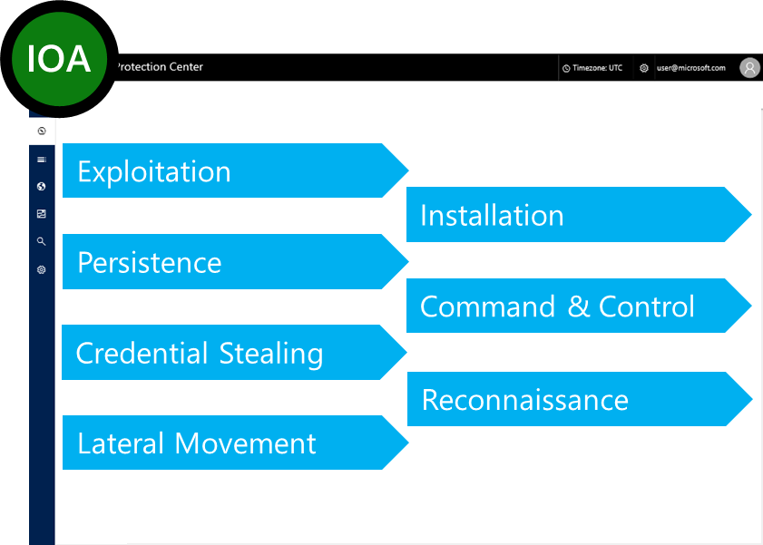
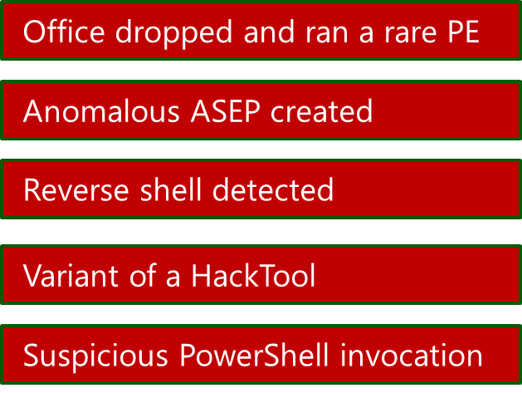
Indications Of Attack (IOAs)
Monitoring “What (whom) we don’t recognize – yet”
Generic IOA Dictionary of attack-stage behaviors, tools, and techniques
Notes:
We decided to depend on behaviors. Windows Defender ATP has an ever growing dictionary of Indications of Attack. These are behaviors that we associate with different attack stages.
We have behaviors that are typical of
exploitation
gain persistence
command and control
the reverse shell that we saw
credential stealing
recon (reconnaissance) – so we are looking for port scanners
lateral movement
In this way we are not only able to monitor you network for what we know. And if a new IOC or IOA comes out, we also go back in time, over the data that’s been collected from your machines and are able to tell you “we only now know that this is an IOC, but it was here a week ago. “
This is really the underlying way in which Windows Defender ATP is able to monitor actors and new actors, known techniques and unknown techniques.

Slide 8
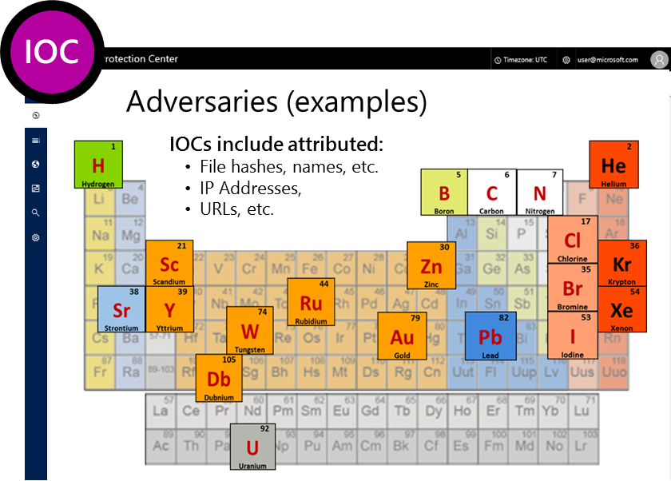
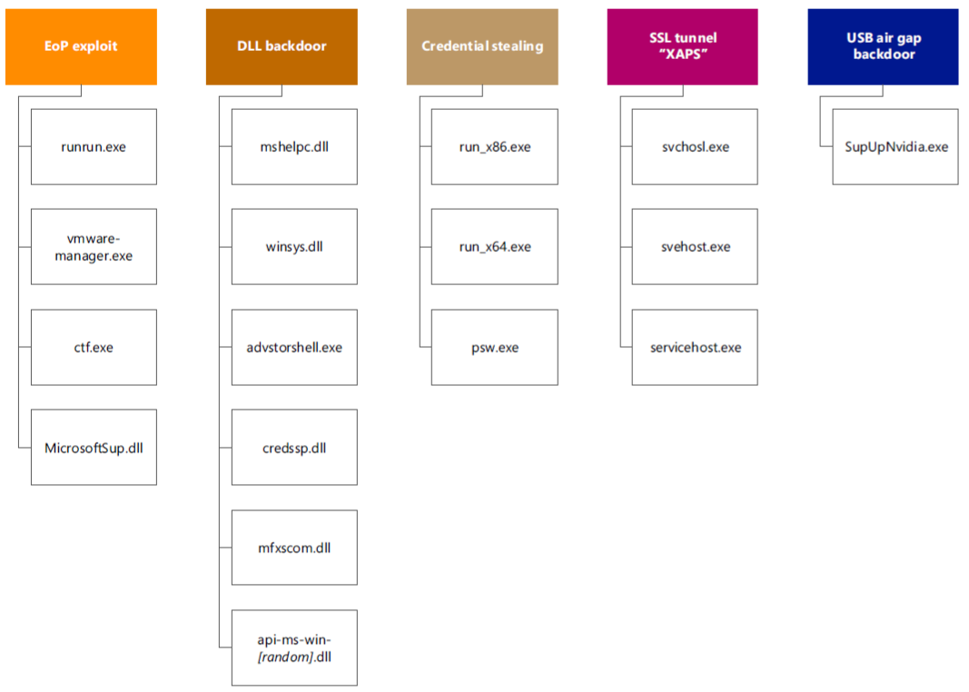
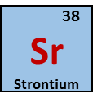
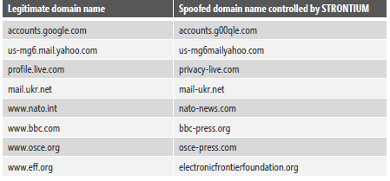
Indicators Of Compromise (IOCs)
Monitoring “What (who) we know”
Threat Intelligence database of known adversary and campaign IOCs
Strontium IOCs – files and spoofed domains
Notes:
Let me tell you a bit more about what we do with these alerts.
The alerts that we use, are based on two terms if you will. IOAs and IOCs
Indicators of Compromise are really what we know and who it belongs to. This is the known. What we do is, we have a TI database that is compiled out of everything we know and everything our TI partners know.
If we see any of these indicators in an organization, then we know who is there.
We, Microsoft, name our actors after the periodic table, so after elements. Each company has their own names for actors. Here is an example of what the indicators are that we know about the actor group called Strontium. A whole set of the tools and techniques they use for different attacks, credential stealing, backdoors, etc…
In addition we also collect the spoofed domains, if we see any communication from a machine - even going out over a system file - to one of those domains or IP’s, we raise an alert and we have an indicator that this actor group was on your box.
What you know is great, but advanced attackers are really well funded, they are sophisticated, they have Zero Days – a zero day by definition is not contained in what we know. So what we have to do, is expand what we know to what or to whom we don’t know yet. And for this <click>

Slide 9
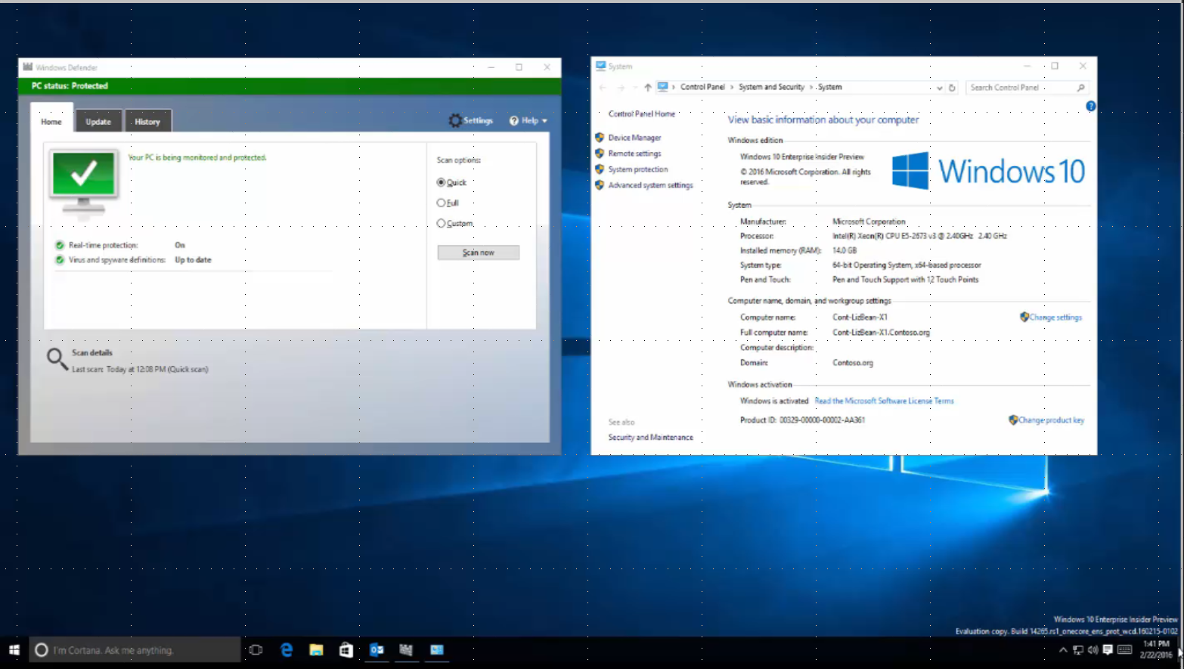
Notes:
Notes: please download and include the demo video here filename: “Windows Defender ATP - Full Demo”
If you prefer to do the talking rather than playing the voice over, you can find the narration in the file “Windows Defender ATP - Full Demo Narration”

Slide 10
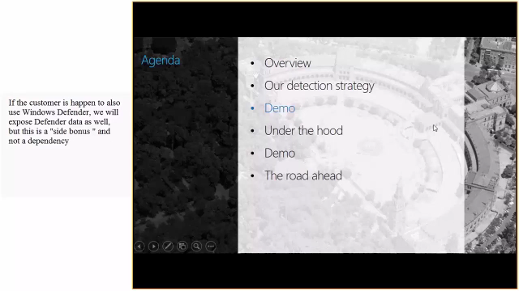

Slide 11
What have we seen
Delivery
Installation
Persistency
Reconnaissance
Lateral Movement
Email with weaponized document received
user opens the mail attachment
Install.exe executes PowerShell
PowerShell communicate with server to download payload and runs it by invoking cmd.exe
Attacker registers the backdoor to run ASEP (sysdebugger.exe)
The attacker collects information, and sends to C&C
Attacker ran downloaded port scanner (sl.exe) to survey the network
WinATP Alert
WinATP Alert
WinATP Alert
WinATP Alert
WinATP Alert
NERO-BLAZE
WinATP Alert
02/25
06:21:00 UTC
02/25
08:06:18 UTC
02/25
08:06:32 UTC
02/25
08:07:00 UTC
02/25
08:47:41 UTC
02/25
08:08:32 UTC
02/25 UTC
02/25
12:21:44 UTC
Outlook drops PE under %Users% folder (install.exe)
Outlook ran the dropped PE
A suspicious PowerShell script executed by install.exe
Suspicious PowerShell communicates with external IP and executed cmd.exe with redirected handles
PowerShell runs cmd.exe
cmd.exe runs reg.exe
PowerShell communicated with external IP
C2 IP attributed to NEROBLAZE attacker, based on Threat Intelligence
Ports canning over TCP & UDP pattern
Notes:
Attack steps:
Attacker crafts an email with an attachment in the <> format which contains an exploit of an Outlook OLE-related vulnerability as described in the #BadWinMail article. The spear-phishing email is sent to the victim in our demo organization, with some text luring them to open the attachment.
The victim opens the attachment that invokes the exploit and results in a malicious PE file being written to the %temp% folder and executed.
The malicious executable runs a PowerShell script in a hidden/stealthy manner
The script opens a remote reverse shell to the attacker
It also registers mtr2.dll in the ASEP runkey to achieve persistence
Finally, a port scanner is downloaded to the victim’s machine in preparation for lateral movement to other machines.

Slide 12
Windows Defender Advanced Threat Protection
helps enterprise customers detect and remediate Advanced Attacks and data breaches
Built into Windows
No additional deployment & Infrastructure. Continuously
up-to-date, lower costs.
Behavioral based, cloud powered
post-breach detection
Actionable, correlated alerts for known and unknown adversaries Real-time and historical data
Rich timeline for investigation
Easily understand scope of breach Data pivoting across endpoints
Deep files and URLs analysis
Unique threat intelligence knowledge base Unparalleled threat optics provides detailed actor profiles
1st and 3rd party TI data
Notes:
Windows Defender ATP brings you the following values
Endpoint APT protection built into Windows
It’s simple, native part of Windows 10 code, no additional deployment required, switch on through configuration. Continuously up-to-date, lowers costs.
Behavior based, cloud powered, advanced attack detection
Finds the attacks that made it past all other defenses (Post breach detection), provides actionable, correlated alerts for known and unknown adversaries trying to hide their activities on endpoints.
Rich timeline for forensic investigation and mitigation
Easily investigate scope of breach or suspect behaviors on any machine through a rich machine timeline. File, URLs and network connection inventory across the network. Gain additional insights using deep collection and analysis (“detonation”) for any file or URLs.
Built in threat intel knowledge base Unparalleled threat optics provides actor details and intent context for every threat intel-based detection – combining 1st and 3rd party intelligence sources

Slide 13


Conceptual architecture
WDATP Geo Unit
(Europe)
Telemetry Processing
APT Detection
Command and Control
Samples Gathering
Detonation
UX
WDATP Geo+DR Unit
(Europe)
Telemetry Processing
APT Detection
Command and Control
Samples Gathering
Detonation
UX
Organization 1 (EU)
Internet
WDATP Central Unit
(US)
Big Data Processing
Threat Intelligence
Detonation
Service Management
WDATP Geo Unit
(US)
Telemetry Processing
APT Detection
Command and Control
Samples Gathering
Detonation
UX
WDATP Geo+DR Unit
(US)
Telemetry Processing
APT Detection
Command and Control
Samples Gathering
Detonation
UX
Organization 2 (US)
Notes:
US – Central US (Des Moins, Iowa) and East US (Boydton, Virginia)
EU – Amsterdam, Netherlands (West Europe) and Dublin, Ireland (North Europe)

Slide 14
Always-on endpoint behavioral sensors
Forensic collection
Threat Intelligence from partnerships
Security analytics
Behavioral IOAs Dictionary
Threat Intelligence by Microsoft hunters
Customers‘ Win 10
Known adversaries
unknown
Files and URLs detonation
SecOps console
Exploration
Alerts
Response
Customers' Windows Defender ATP tenant
SIEM
Windows APT Hunters, MCS Cyber
SIEM / central UX
Customers‘ SIEM
Notes:
The Windows Defender ATP agent is embedded into Windows 10, which mean no additional deployment is required and also no additional infrastructure on-prem is required. All the logic happens in the cloud. The agent is responsible to log everything that happens on the client machine and send it over to the cloud. The agent is also responsible for collecting other forensic data, such as PE files, and will have remediation capabilities at a la later point. The agent knows where to send the data to, because of an Organization certificate, which gets installed during the onboarding process. The cloud backend is based on Azure services, designed for scale (endpoints, Organizations, users, data) and gets built for compliance. Each customer has its own Windows Defender ATP tenant, where its data gets stored and any access to the data is limited to authorized SecOps only and fully audited. The portal is also hosted in this tenant and uses Microsoft Azure AD accounts to authenticate. During the onboarding process, the customer has to provide an Azure Active Directory account and additional accounts can be added to grand access. Each tenant also has its own detonation chamber, which mean files will not even leave the tenant for deep file analyses. Before cyber data leaves the customer tenant (for instance to provide optics to our APT Hunters), all personal identifiable information (PII) data gets removed. Every tenant gets enriched with a global threat intelligence knowledge base, which is combined of our own 1st party threat intelligence as well as with 3rd party intelligence sources (we will share more about our partners at a later point). We are working on providing SIEM connectors for the most popular SIEM vendors, starting with Splunk for GA. At this point we do not commit to customers what connector will be available at what time, as we are still developing the product as well as the SIEM connectors. If customers are using a different SIEM they can use our APIs to pull alerts into their SIEM system.

Slide 15

High-level architecture
Geo-Distributed Scale Unit
Win10 Device
Customer Portal
Customer AAD
SENSE
Agent
UX & Tools
OAUTH2
Command &
Control
JSON/HTTPs
WDATP UX
Sample
Collection
Detonation
Cyber Data
Comm.
Application
Services
Customer
Detection
Response
Threat Intelligence
Samples
Uploads
BOND/HTTPs
Commands & Control
UTC/HTTPS
Service
Health
Business
Logic
Cyber Data
R/T Processing
Command &
Control
Cyber Data Events
Blob/REST+SAS over HTTPs
Scanners
Samples
Customer data/PII
Customer
Samples
Operational
Data
Health Data
Configuration
Data
Service Health
Behavioral
Engine
Interactive Data Platform
Detonation
Platform
Platform
Sensor
Drivers
Data Retention, Service Management, Monitoring
Auditing, Obfuscation & Encryption,
User/Device Authorization & Authentication
Azure
Cosmos
MCIO
Client
MICROSOFT CONFIDENTIAL, NDA

Slide 16
Data and Compliance
Client threat data collection
Sample Collection
Telemetry, automatically collected from on-boarded endpoints, serves to proactively identify indications of attack and can be viewed by customer SecOps. Threat insights are shared among Seville customers
Seville can be configured to collect samples upon identifying IoAs or suspicious activities, which enables deeper analysis to identify potential threats. Sample collection can be performed automatically for fast detection, or manually after SecOps’ explicit approval
Geolocation
Compliance and Privacy
Enterprise data will have geo-affinity to a single Data Center geo-location. Each enterprise can select their preferred data center location from available Azure data center locations
All customer data resides in compliant storage (Windows Azure), isolated from data of other customers, and secured by access control with full auditing and logging capabilities. PII data anonymized prior to aggregation and processing

Slide 17
Compliance principles
Satisfy privacy & regulatory requirements
Provide assurance data is appropriately handled
RS1 - ISO27001 (certification post GA)
Data is classified as either Customer data (with or w/o PII) or Microsoft data
Customer data is stored in an Azure compliant storage, located in a customer-selected geo-affinity data center (US and EU in RS1)
Each customer data is logically isolated from others
Data is encrypted at movement between services boundaries
Retention policy is enforced on customer data
All user/system actions are audited and logged on customer data

Slide 18






Market Opportunity - 2013-2019 ($M)
Newly recognized market Enterprise Detection & Response (EDR) by Gartner Specialized Threat Analysis & Protection (STAP) by IDC
Over $3 Billion Market in 2019
27.6% CAGR over the next 5 yrs.
source IDC

Slide 19
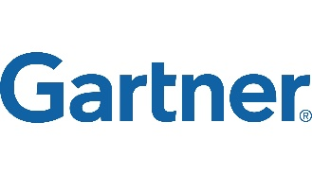
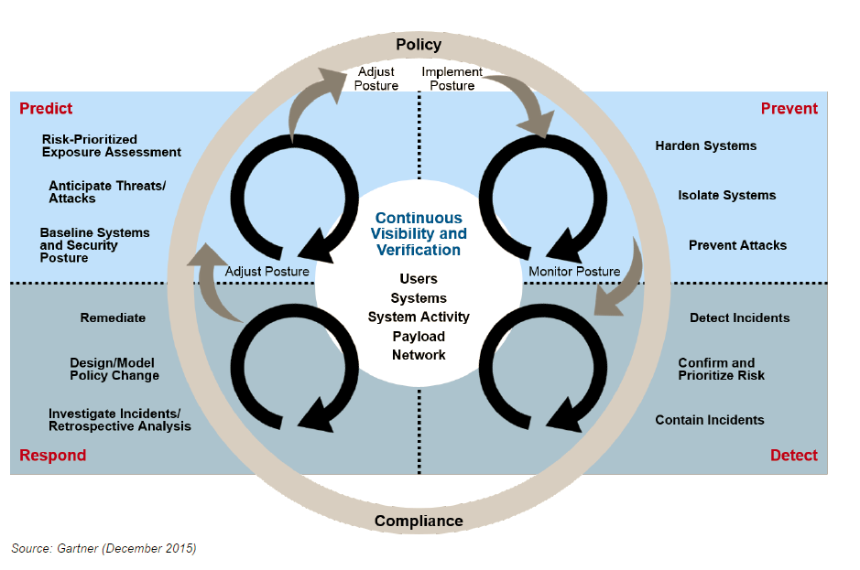
Endpoint Detection & Response (EDR)
Definition: solutions that have the following capabilities:
Contain the incident at the endpoint
Detect security incidents
Investigate security incidents
Remediate endpoints to a pre-infection state
EDR delivers on the bottom half of Gartner's Adaptive Security Architecture
Notes:
MSPP players – Dell – redcloak – secureworks; IBM, BT – managed in product
EPP are stepping up – AV vendor moving
MSPP
Startup using the momentum

Slide 20
Market Opportunity – Windows Defender ATP
Worldwide Specialized Threat Analysis and Protection market is forecasted to more than double from 2015 to 2019, to over $3 billion/year
Microsoft is making significant and sustained investments in the security space
Windows Defender ATP will deliver security capabilities above and beyond those found in Windows Enterprise.
Windows Defender ATP will be offered to VL customers as an add-on to Windows Enterprise
This allows Microsoft to target the customers who want & value the ATP capabilities without raising prices on the base Enterprise VL offer
Windows Defender ATP will be available for both device and user-based license options
Windows Defender ATP will be offered as a Windows license or a combined bundle with other similar Microsoft products (e.g. Office E5)
Notes:
*Plan- not locked*
Emerging market
The ATP market is quickly evolving- our research indicates that a large portion of enterprise customers are likely to purchase an ATP solution of some sort in the next two years. Spending in 2016 is expected to reach $2B, and be over $3B/year by 2019.
Microsoft Investment
Microsoft is entering this market with Windows Defender ATP later this year and are planning to make sustained investments in this area across engineering, security intelligence, and sales & marketing. We are positioned very well to capitalize on this growing market, Stella and team spoke to many of our competitive advantages already. This is particularly true with our existing Windows Enterprise/SA customers.
Premium Upsell
Windows Defender ATP will deliver advanced security value to customers above and beyond the level of security that is built into Windows Enterprise (Credential Guard, Device Guard, Bitlocker, etc).
Windows Defender ATP will be sold through a dedicated sales motion as a new offering to our volume licensing customers as an upsell from Windows Enterprise.
This business model allows Microsoft to target the customers who want and value the advanced ATP capabilities, without raising prices on the base Enterprise VL offer.
Windows Defender ATP will be available for both device and user-based license options. Pricing is not finalized but based on customer willingness to pay and current ATP industry pricing levels, we believe it will be priced on par with the base Windows Enterprise VL offer.

